Slide 1
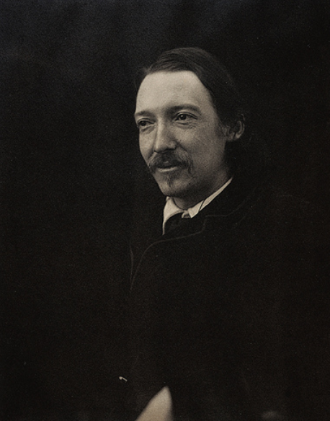
A. Context and Key Ideas in the Novella
Robert Louis Stevenson and his background | Born in Edinburgh in Scotland in 1850 and came from a family of scientists, engineers, religious figures and even a professor of philosophy. Stevenson was interested in the relationship between science and nature As a child, Stevenson was often very ill – including suffering from lung problems – who would often distract himself from his illness by reading about travel and adventures. This later inspired him to write ‘Treasure Island’ and he would travel the world before dying in the Samoan Islands in the South Pacific in 1894 at the relatively young age of 44. Stevenson’s illness meant he would often suffer from nightmares and this influenced his writing in Jekyll and Hyde.
Charles Darwin and ‘On The Origin of Species’ | In 1859 Charles Darwin published his famous ‘On the Origin of Species’, which explained Darwin’s Theory of Evolution. This introduced the idea of animals changing in response to their environments through mutations at birth, or evolving. This theory questioned accepted Christian beliefs that the world was created in seven days. Many people within society also struggled to accept the idea that humans could have evolved from other animals such as chimpanzees as it directly opposed religious beliefs
The Duality of Humanity | Jekyll and Hyde was published in 1886 and only two years later the Jack the Ripper murders were causing chaos and panic in London. A series of violent attacks took place on prostitutes across the city with five being killed by the mysterious Ripper. Rumours were spreading that the serial killer could be middle or upper class, challenging the idea that those high up in society were naturally good and morally strong. This led to the exploration of good and evil (the duality) of human nature.
Religion vs. Science | Christianity was the predominant religion in Britain at the time the novella was written, but its influence was declining. Science and religion are two very important themes in the novella, and at this time many felt science and religion were increasingly in opposition – to believe in one meant you could not believe in the other.
B. Context and Literary Choices
Allegory | The novella can be argued to be an allegory – a story with a moral purpose. Hyde and Jekyll represent good and evil, Utterson represents friendship, reputation and responsibility, and Enfield and Utterson’s discussions represent secrecy. The plot allows for philosophical and moral debate.
Detective fiction | Utterson’s determination to find out the secrets include many genre conventions associated with detective fiction. Utterson hunts for clues, ‘interviews’ Hyde and Jekyll and eventually solves the mystery.
Gothic Horror | Classic gothic conventions seen are: the dark and mysterious atmosphere, old and decrepit buildings and winding passageways, and a protagonist whose true identity is revealed.
Duality / Juxtaposition | Lots of contrast in terms of setting, character and themes including: appearance vs. reality, Jekyll and Hyde, light and dark. This is to highlight the opposing elements of human nature.
Victorian London | Population grew: 1 million in 1800 to 6.7 million in 1900 Became the biggest city in the world and centre for politics, finance and trade. As London grew wealthy, poverty in the city also grew. Overcrowding led to crime.
Victorian Values | From the 1850s to the early 1900s, British society outwardly displayed valued of sexual restraint, low tolerance of crime, religious morality and a strict code of conduct. Utterson is the stereotypical Victorian male.
YEAR 9 - English
Jekyll and Hyde
Knowledge Organiser
C. Character summary
Dr Gabriel Utterson | A calm and rational lawyer and friend of Jekyll.
Dr Hastie Lanyon | A conventional and respectable doctor and former friend of Jekyll.
Dr Henry Jekyll | Well respected in Victorian society, Jekyll is a doctor of medicine with many friends. A doctor and experimental scientist who is both wealthy and respectable.
Mr Edward Hyde | A small, heavily disfigured and deformed man, who is described as ‘ape like’ but also a ‘juggernaut’. Hyde is described as not being human and unnatural, as if he is not quite evolved. People seem to feel a natural disgust for Hyde and he is unrepentant.
Sir Danvers Carew | A distinguished gentleman who is beaten to death by Hyde.
Richard Enfield | A distant relative of Utterson and well-known man about town.
Poole | Jekyll’s manservant.
Mr Guest | Utterson’s secretary and handwriting expert.
Notes:
Key messages:
Is all content presented clearly? All diagrams etc. should be legible for students to access.
Does the layout allow for testing opportunities in class and in morning meeting? The above layout gives a clear indication of term on one side with the definition or description on the other.
Are there challenge tasks for students to complete?
Does the content link explicitly to the content covered in the SoW?
Is some content emboldened for clarity?

Slide 2
D. Vocabulary
Aberration | Abnormal
Abhorrent | Monstrous, abhorrent, disgusting
Allegory | Moral or political message
Allusion | Reference
Anxiety | Nervousness
Atavism | Evolutionary throwback
Consciousness | Awareness
Debased | Become lower
Degenerate | A decline in ability
Depraved | Morally corrupt
E. Vocabulary
Duality | Two aspects explored
Duplicity | Lying or dissembling
Epistolary | Story written in letter form
Eugenics | Population control
Evolution | Slow change over many years
Feral | Wild
Metamorphosis | Change
Perversion | Corruption from the original
Restraint | Holding oneself back
Unorthodox | Against the usual

